Slide 1

On writing well
Classic Principles for Clear, Concise Prose
By Dr. Les Sillars
Professor of Journalism and Associate Dean of Academics
Patrick Henry College

Slide 2
On writing well
To write is to think, and to
write well
is to
think well.
--historian David McCullough

Slide 3
On writing well
I write
because I don’t know what I think
until
I read what I say.
--novelist Flannery O’Connor

Slide 4
On writing well
GOOD
WRITING
1. is grammatically correct;
2. is clear, direct, and concise;
3. is well-organized with a discernible progression and structure;
4. displays style and word choices appropriate to the context; and
5. displays unity of content.

Slide 5
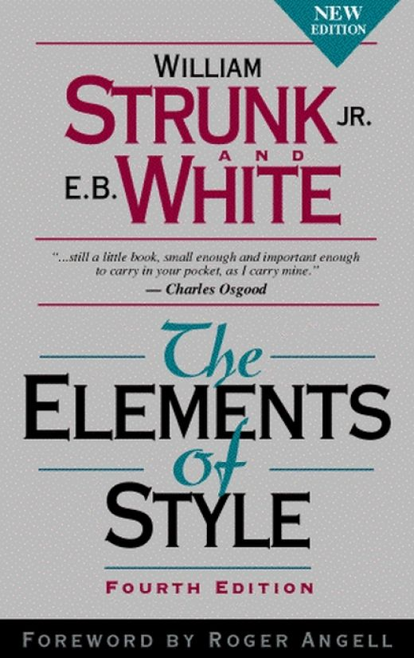
On writing well
GOOD
WRITING

Slide 6
On writing well
GOOD
WRITING
1. is grammatically correct;
2. is clear, direct, and concise;
3. is well-organized with a discernible progression and structure;
4. displays style and word choices appropriate to the context; and
5. displays unity of content.

Slide 7
On writing well
Good writing is clear, direct, and concise.
It is not, however, simplistic
or even necessarily simple.
The effective expression of an idea
may require complex sentence
structure. However, you cannot write a
complex sentence until you learn to
write simple sentences
well.

Slide 8
On writing well
The boy was big.
The ball was round and white.
The ball was hit by the boy.
The ball went a long way.

Slide 9
On writing well
The boy was big.
The ball was round and white.
The ball was hit by the boy.
The ball went a long way.
CONDENSE

Slide 10
On writing well
The boy was big.
The ball was round and white.
The ball was hit by the boy.
The ball went a long way.
The big boy hit the white ball a long way.

Slide 11
On writing well
The boy was big.
The ball was round and white.
The ball was hit by the boy.
The ball went a long way.
How did we get from here to here?
The big boy hit the white ball a long way.

Slide 12
On writing well
The boy was big.
The ball was round and white.
The ball was hit by the boy.
The ball went a long way.
The big boy hit the white ball a long way.
Recast sentences to avoid unnecessary
  uses of the verb “to be”; focus on the main verb.

Slide 13
On writing well
Recast sentences to avoid unnecessary
  uses of the verb “to be”; focus on the main verb.
  There was a man who went to the store.

Slide 14
On writing well
Recast sentences to avoid unnecessary
  uses of the verb “to be”; focus on the main verb.
  There was a man who went to the store.
  A man went to the store.

Slide 15
On writing well
Recast sentences to avoid unnecessary uses of the verb “to be”
Ghosts and ghouls, superheroes and princesses, cute, little waddling pumpkins holding pumpkin shaped buckets almost as large as they are, this is the modern picture of suburban Halloween. American culture is divided about the topic of Halloween particularly in Christian circles. This is often because of the tenuous connection to Satan and other unholy and unsavory things. However, this is not the true historical context for Halloween. Although it is true that Halloween stems from pagan, specifically Celtic, traditions, it was not a celebration of death, but a celebration of life.

Slide 16
On writing well
Recast sentences to avoid unnecessary uses of the verb “to be”
Ghosts and ghouls, superheroes and princesses, cute, little waddling pumpkins holding pumpkin shaped buckets almost as large as they are, this is the modern picture of suburban Halloween. American culture is divided about the topic of Halloween particularly in Christian circles. This is often because of the tenuous connection to Satan and other unholy and unsavory things. However, this is not the true historical context for Halloween. Although it is true that Halloween stems from pagan, specifically Celtic, traditions, it was not a celebration of death, but a celebration of life.

Slide 17
On writing well
Recast sentences to avoid unnecessary uses of the verb “to be”
Ghosts, ghouls, superheroes, princesses, and waddling little pumpkins holding orange plastic buckets will descend on American suburbs late next week to collect their candy tribute. In recent decades some Christians have shied away from Halloween because of its connection to the unholy and the unsavory but, ironically, the Celts founded the pagan holiday not to honor death but to celebrate life.

Slide 18
On writing well
The boy was big.
The ball was round and white.
The ball was hit by the boy.
The ball went a long way.
The big boy hit the white ball a long way.
1. Recast sentences to avoid forms of the verb “to be”;
focus on the main verb.
2. Write in the active voice.

Slide 19
On writing well
The boy was big.
The ball was round and white.
The ball was hit by the boy.
The ball went a long way.
The big boy hit the white ball a long way.
1. Recast sentences to avoid forms of the verb “to be”;
focus on the main verb.
2. Write in the active voice.
3. Avoid redundancies.

Slide 20
On writing well
The boy was big.
The ball was round and white.
The ball was hit by the boy.
The ball went a long way.
The big boy hit the white ball a long way.
1. Recast sentences to avoid forms of the verb “to be”;
focus on the main verb.
2. Write in the active voice.
3. Avoid redundancies.
4. Pack information into sentences using
strong, vivid verbs and specific, concrete nouns.

Slide 21
On writing well
1. Recast sentences to avoid forms of the verb “to be”;
focus on the main verb.
2. Write in the active voice.
3. Avoid redundancies.
4. Pack information into sentences using
strong, vivid verbs and specific, concrete nouns.
The big boy hit the white ball a long way.
Jumbo Casey ripped a double to deep
left-center field.

Slide 22
On writing well
Good writing is well organized with a discernable progression and structure.
Structure your prose from verb to verb
Passing alongside the Sea of Galilee, he saw Simon and Andrew the brother of Simon casting a net into the sea, for they were fishermen. And Jesus said to them, “Follow me, and I will make you become fishers of men.” And immediately they left their nets and followed him. And going on a little farther, he saw James the son of Zebedee and John his brother, who were in their boat mending the nets. And immediately he called them, and they left their father Zebedee in the boat with the hired servants and followed him. Mark 1:16-20

Slide 23
On writing well
Good writing is well organized with a discernable progression and structure.
Structure your prose from verb to verb
Passing alongside the Sea of Galilee, he saw Simon and Andrew the brother of Simon casting a net into the sea, for they were fishermen. And Jesus said to them, “Follow me, and I will make you become fishers of men.” And immediately they left their nets and followed him. And going on a little farther, he saw James the son of Zebedee and John his brother, who were in their boat mending the nets. And immediately he called them, and they left their father Zebedee in the boat with the hired servants and followed him. Mark 1:16-20

Slide 24
On writing well
Good writing is well organized with a discernable progression and structure.
II. Avoid unnecessary transitions
Public speakers are often advised, “Tell them what you’re going to say, say it, and then tell them what you said.”

Slide 25
On writing well
Good writing is well organized with a discernable progression and structure.
II. Avoid unnecessary transitions
Public speakers are often advised, “Tell them what you’re going to say, say it, and then tell them what you said.”

Slide 26
On writing well
Good writing is well organized with a discernable progression and structure.
II. Avoid unnecessary transitions
You may occasionally need to review what you have already written, especially in a long document. But generally speaking, prose should draw the reader forward with new information in every line. Give readers credit for being able to follow a well organized train of thought; overexplaining is not only boring and redundant, it’s condescending. Also, readers (and teachers) can tell when you’re just padding your word count.

Slide 27
On writing well
Good writing is well organized with a discernable progression and structure.
II. Avoid unnecessary transitions
E.g.
There are several benefits for those who work or write for the Law Review. First, the experience one would gain from participating in the Law Review would add well to one’s resumé in the future—and not just for those who want to become lawyers. “It begins to set you out,” he said. “We begin to set up a scenario that you look different than other students coming in from different schools.”
Second, the Law Review offers experience necessary for law school prospects to impress law schools. Obviously, there will be many opportunities to research law and legal precedent, which is the mission of the Law Review, but additionally, Reeves highlighted the importance of learning the Bluebook citation style.

Slide 28
On writing well
II. Avoid unnecessary transitions
E.g.
There are several benefits for those who work or write for the Law Review. First, the experience one would gain from participating in the Law Review would add well to one’s resumé in the future—and not just for those who want to become lawyers. “It begins to set you out,” he said. “We begin to set up a scenario that you look different than other students coming in from different schools.”
Second, the Law Review offers experience necessary for law school prospects to impress law schools. Obviously, there will be many opportunities to research law and legal precedent, which is the mission of the Law Review, but additionally, Reeves highlighted the importance of learning the Bluebook citation style.
Experience on the Law Review would be a helpful credential for an undergraduate resumé, and not just for aspiring lawyers. “It begins to set you out,” Reeves said. “We begin to set up a scenario that you look different than other students coming in from different schools.” It also teaches students important aspects of legal research, he added, especially the Bluebook citation style.

Slide 29
On writing well
Good writing is well organized with a discernable progression and structure.
Compose “true topic sentences.” (Thanks, Dr. Spinney)
Crafting a true topic sentence for each of an essay’s paragraphs is the key to writing an impressive argumentative essay. Never write pseudo-topic sentences that only announce the paragraph’s subject. Example of a pseudo-topic sentence: The Puritans valued education. Unlike this example, a true topic sentence makes a claim or assertion that supports the essay’s thesis. Hence a true topic sentence declares an argument that is one element of the essay’s overall argument. (In our HIS203 and HIS213 essays, the argument should be a persuasive answer to the assigned question.) Example of a true topic sentence: The Puritans’ classical liberal arts education created independent thinkers who would never submit to authoritarian governance.

Slide 30
On writing well
Good writing is well organized with a discernable progression and structure.
Compose “true topic sentences.” (Thanks, Dr. Spinney)
Not a True Topic Sentence (NATTS): The Puritans made rules to distinguish between legitimate and illegitimate sports.
A Healthy Topic Sentence (AHTS): Rule-making becomes legalistic bondage when it subjects even recreation to laws and punishments.
NATTS: The Puritans enjoyed affectionate marriages.
AHTS: Affectionate marriages–like the ones the Puritans enjoyed–promote emotionally satisfying societies, not grim and repressive ones.

Slide 31
On writing well
STORYTELLING
Stories define cultures.

Slide 32
On writing well
STORYTELLING
Stories define cultures.
So the question is:

Slide 33
On writing well
STORYTELLING
Stories define cultures.
So the question is:
Are you content to
be told
those stories?

Slide 34
On writing well
STORYTELLING
Stories define cultures.
So the question is:
Or do you want to
tell
them?

Slide 35
On writing well
STORYTELLING
Journalism at PHC
phc.edu/journalism
journalism
public relations/communications
advocacy/ministry
analysis/education
graphic design/multimedia

Slide 36
On writing well
STORYTELLING
phc.edu/journalism
To get the
slideshow:
ldsillars@phc.edu

